Slide 1




Slide 2

TEST TIME ON SWAP TWO NIBBLES IN A BYTE
URL: https://forms.gle/4tAwWTB5Mzk4ryx77
QR CODE:

Slide 3

BLOCK SWAP ALGORITHM

Slide 4
Introduction:
The Block Swap algorithm, also known as the Array Rotation algorithm, is a technique used to rotate the elements of an array by a given number of positions.
The algorithm operates by dividing the array into two blocks and then swapping the elements between these blocks in a specific manner.

Slide 5
Block Swap algorithm:
Input: The algorithm takes as input an array of elements and the number of positions by which the array needs to be rotated.
Divide the array into two blocks:
Block 1: This block consists of the first "d" elements of the array, where "d" is the number of positions to rotate.
Block 2: This block contains the remaining elements of the array.

Slide 6
Swap the elements between Block 1 and Block 2:
The algorithm performs a simple swap operation, where it exchanges the elements at corresponding positions in Block 1 and Block 2.
After the swap, you will have two separate blocks:
Block 1: This block now consists of the elements that were originally in Block 2.
Block 2: This block now contains the elements that were originally in Block 1.

Slide 7
By repeating these steps, the algorithm gradually rotates the array by the specified number of positions.
It continues dividing the array into two blocks and swapping their elements until the entire array has been rotated.

Slide 8
Example:array [1, 2, 3, 4, 5] and we want to rotate it by 2 positions.
Initial array: [1, 2, 3, 4, 5]
2.Divide the array into two blocks:
Block 1: [1, 2] (first 2 elements)
Block 2: [3, 4, 5] (remaining elements)
1 | 2 | 3 | 4 | 5
1 | 2
3 | 4 | 5

Slide 9


Swap the elements between Block 1 and Block 2:
3.After Swapped array: [3, 4, 5, 1, 2]
4.Separate the swapped array into two blocks:
Block 1: [3, 4, 5] (original Block 2)
Block 2: [1, 2] (original Block 1)
3 | 4 | 5
1 | 2

Slide 10

5. Repeat steps 2-4 once more:
Block 1: [3, 4] (first 2 elements from Block 1)
Block 2: [5, 1, 2] (remaining elements from Block 1)
Swapped array: [5, 1, 2, 3, 4]
6.The final array after rotating by 2 positions is [5, 1, 2, 3, 4].
3 | 4
5 | 1 | 2
5 | 1 | 2
5 | 1 | 2 | 3 | 4

Slide 11
Time and space complexity
time complexity of O(n)
where n is the number of elements in the array.
space complexity O(1)
since it performs the rotation in place without using additional data structures.

Slide 12
Program
Sample input 1:
10, 20, 30, 40, 50
rotations = 3
Rotated array: 40 50 10 20 30
Sample input 2:
7, 8, 9, 10
rotations = 5
Rotated array: 8 9 10 7

Slide 13
import java.util.*; public class Main { public static void Rotatetoleft(int[] arr, int n, int k) { if (n == 0) return; k = k % n; if (k > n) return; int[] temp = new int[k]; for (int i = 0; i < k; i++) { temp[i] = arr[i]; } for (int i = 0; i < n - k; i++) { arr[i] = arr[i + k]; } | for (int i = n - k; i < n; i++) { arr[i] = temp[i - n + k]; } } public static void main(String args[]) { int n = 7; int[] arr = {1,2,3,4,5,6,7}; int k = 2; Rotatetoleft(arr, n, k); System.out.println("After Rotating the elements to left "); for (int i = 0; i < n; i++) { System.out.print(arr[i] + " "); } } }

Slide 14
public class BlockSwapAlgorithm { public static void rotateArray(int[] arr, int d) { int n = arr.length; d = d % n; if (d == 0) return; swap(arr, 0, d - 1); swap(arr, d, n - 1); swap(arr, 0, n - 1); } public static void swap(int[] arr, int start, int end) { while (start < end) { int temp = arr[start]; arr[start] = arr[end]; arr[end] = temp; start++; end--; }} | public static void main(String[] args) { int[] arr = {1, 2, 3, 4, 5}; int rotations = 2; rotateArray(arr, rotations); System.out.println("Rotated array:"); for (int i : arr) { System.out.print(i + " "); } } }

Slide 15
Interview questions
Describe the Block Swap algorithm and how it works
The Block Swap algorithm is used to rotate an array by a given number of positions. It involves swapping blocks of elements within the array to achieve rotation. The algorithm divides the array into two blocks, A and B, where A has the first d elements and B has the remaining elements. It then performs a series of swaps to move the elements from A to B and vice versa, until the desired rotation is achieved

Slide 16
Interview questions
What is the time complexity of the Block Swap algorithm?
The time complexity of the Block Swap algorithm is O(n), where n is the number of elements in the array.

Slide 17
Interview questions
What are the applications of the Block Swap algorithm?
Rotating elements in an array or a string.
Implementing circular queues or buffers.
Performing cyclic shifts in cryptographic algorithms.
Reordering elements in certain data structures or algorithms.

Slide 18

https://learn.codemithra.com

Slide 19
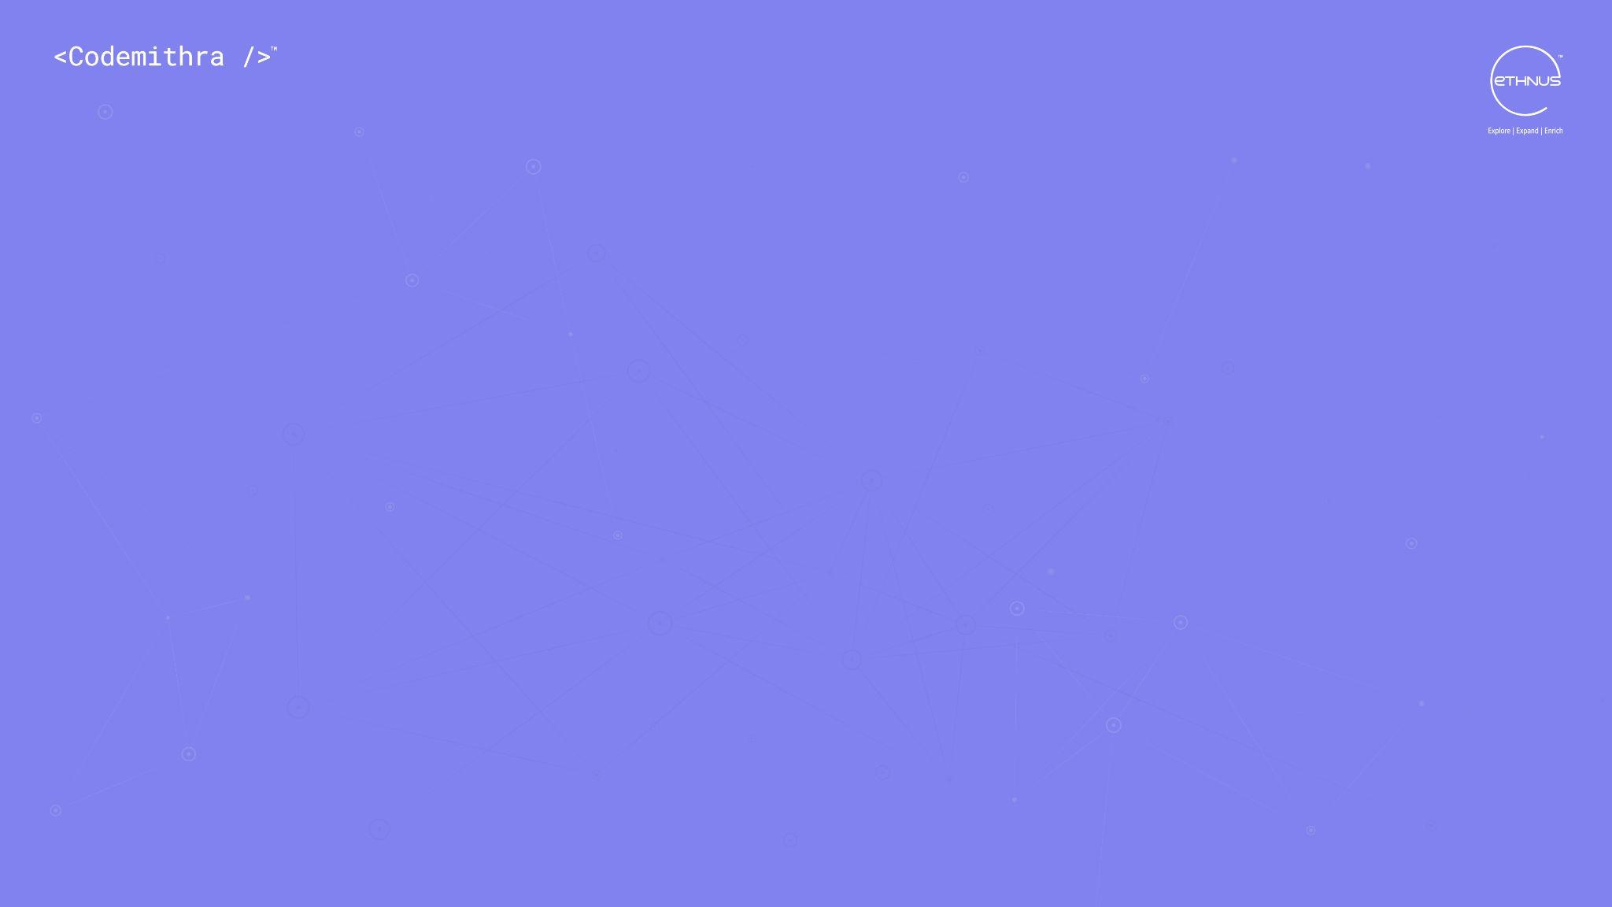



THANK YOU
+91 78150 95095
codemithra@ethnus.com
www.codemithra.com

